Slide 1
Fundamentals of DAX Contexts
James McGillivray (He/Him)
Principal Consultant
Cobalt Analytics

Slide 2



James McGillivray
Power BI
Data Architecture
Data Warehousing
He/Him
Principal Consultant
Cobalt Analytics
/thejimmyrsa
Cricket
Poker
Board Games Musical Theatre
Travel

Slide 3



UNDERSTAND
the theory
We’ll start at the very beginning and build on each layer of knowledge
VISUALISE
the concepts
EXPLORE
in Power BI
We’ll use a visual example to explain each concept
Before exploring a Power BI demo to see our knowledge in action.
SESSION OBJECTIVES
Where we’re going

Slide 4


OUR DATASET
get familiar with the data we’re going to use through the session
agenda
EVALUATION CONTEXT?
let’s start at the very beginning

Slide 5



MODIFYING RELATIONSHIPS
ROW CONTEXT
… row context iterates
not everything is 1:*
FILTER CONTEXT
CALCULATE
filter context filters …
creating filter contexts

Slide 6



SOME EXAMPLES
putting all our knowledge together
CONTEXT TRANSITIONS
QUESTIONS
Not a fundamental
a virtual QnA

Slide 7
Section Title 3
What is Evaluation Context?

Slide 8


Evaluation Context the theory bit
Why?
Intuitive
As soon as you want to move into more complicated analytics, you need to understand evaluation contexts
…but not simple
Evaluation Context

Slide 9
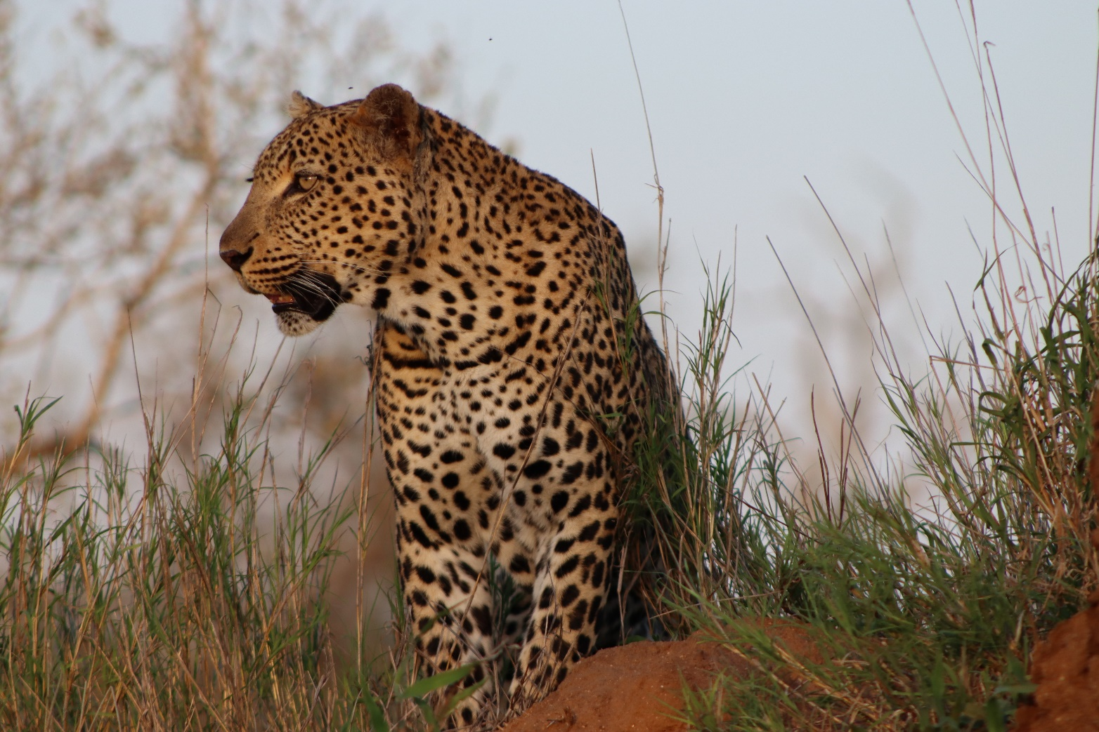
How is the same DAX formula able to return different results?
Each data point is calculated using its own EVALUATION CONTEXT
Evaluation Context

Slide 10


FILTER CONTEXT
ROW CONTEXT
Reduces the data set over which the calculation takes place
Iterates over every row in the data set to perform the calculation
Evaluation Context

Slide 11
FILTER CONTEXT
ROW CONTEXT
filters
iterates
The Definitive Guide to DAX (Marco Russo and Alberto Ferrari)

Slide 12
FILTER CONTEXT
ROW CONTEXT
does not iterate
does not filter
The Definitive Guide to DAX (Marco Russo and Alberto Ferrari)

Slide 13


Evaluation Context the theory bit
Why?
Intuitive
Two Contexts
Every Value
As soon as you want to move into more complicated analytics, you need to understand evaluation contexts
…but not simple
which are not the same
in any output format (Power BI / SSAS / Excel) has its own evaluation context
Evaluation Context

Slide 14
Section Title 3
Our Dataset

Slide 15
Name | Animal Key | Subcategory Key | Time | Type | Primary Subject Colour | Primary Background Colour | Subject Rating | Background Rating | # of Subjects
Hunting Dogs | 1 | 5 | Morning | Group | Black | Brown | 2 | 3 | 8
Brexit? | 2 | 4 | Afternoon | Portrait | Blue | Green | 4 | 4 | 1
Elephant Eye | 3 | 1 | Afternoon | Close-Up | Grey | Green | 4 | 2 | 1
Buffalo Bulls | 4 | 1 | Morning | Group | Brown | Grey | 3 | 3 | 6
Leopard hunt | 5 | 1 | Evening | Close-Up | Gold | Brown | 5 | 4 | 1
Stripes | 6 | 2 | Morning | Group | Black | Green | 2 | 2 | 8
Nyala Drink | 7 | 2 | Afternoon | Group | Brown | Brown | 2 | 2 | 14
Lioness | 8 | 1 | Night | Close-Up | Gold | Black | 4 | 4 | 1
Coffee! | 8 | 1 | Morning | Portrait | Gold | Green | 3 | 2 | 1
Bee-Eaters | 9 | 4 | Afternoon | Scene | Green | White | 4 | 3 | 2
Kingfisher | 10 | 3 | Afternoon | Portrait | Blue | Green | 4 | 4 | 1
Colours | 11 | 4 | Evening | Portrait | Lilac | White | 4 | 3 | 1
Our Dataset

Slide 16
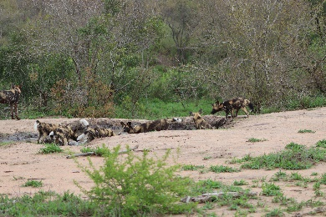
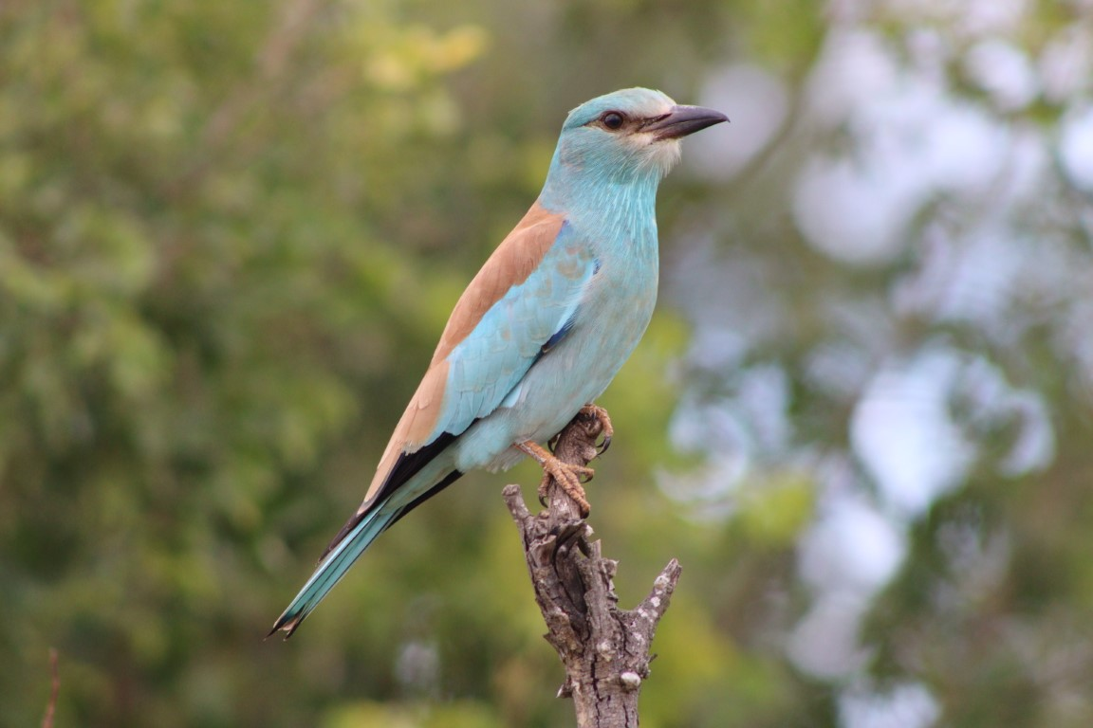
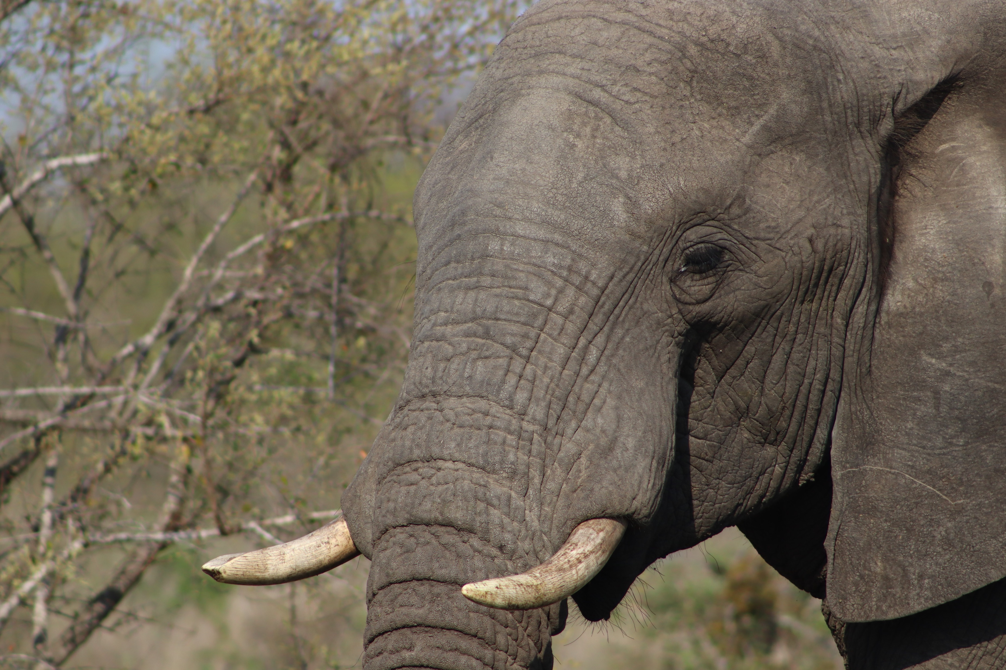
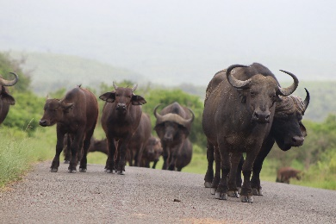
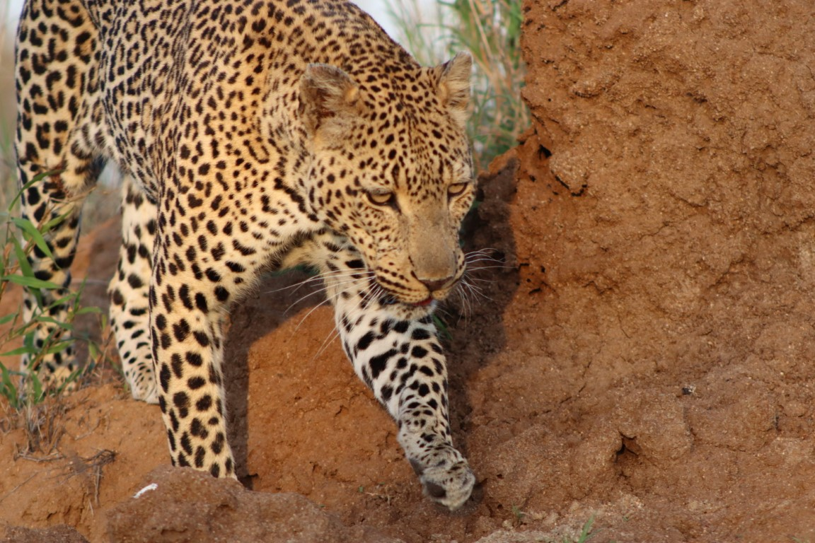
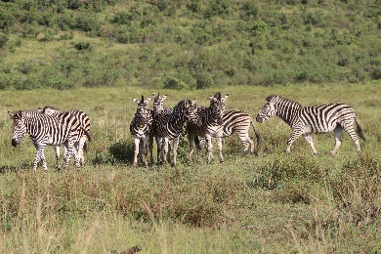
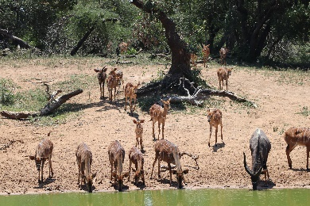
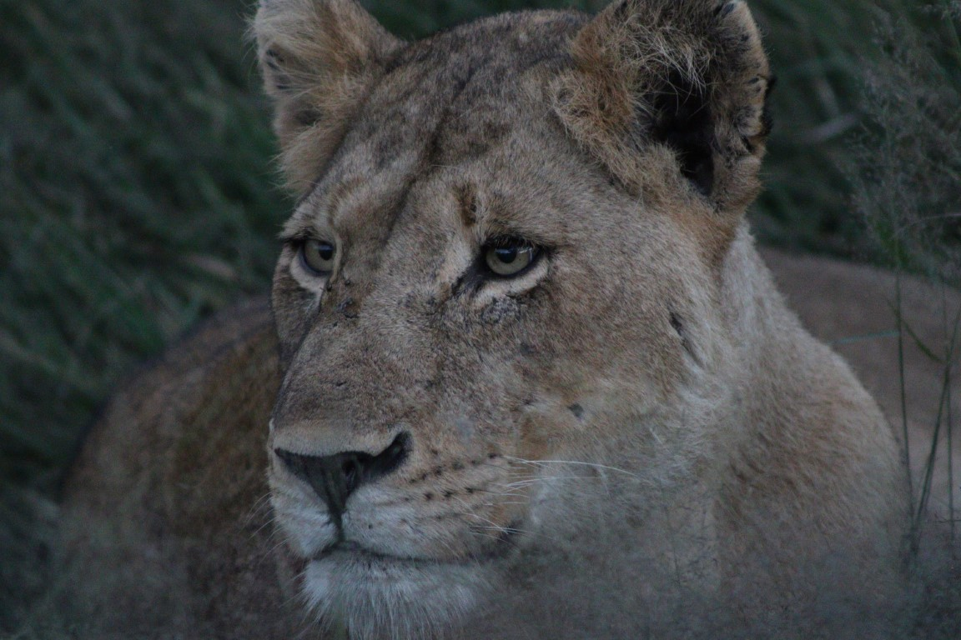
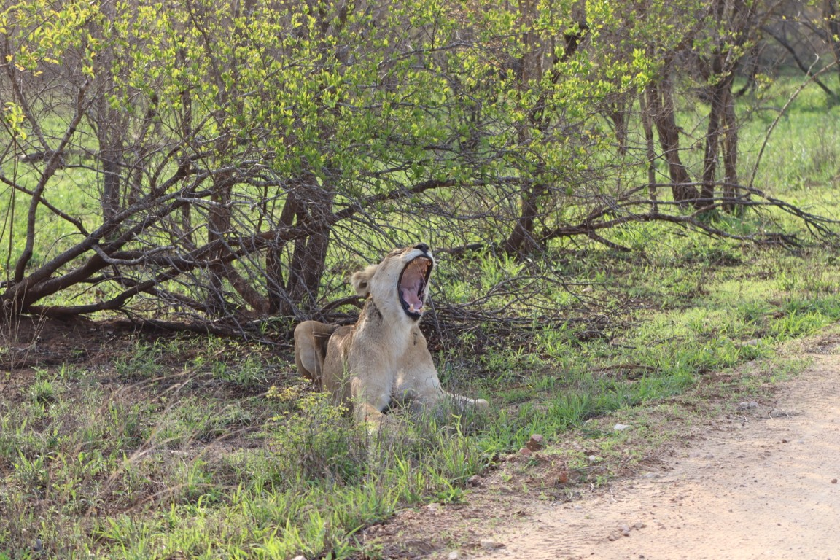
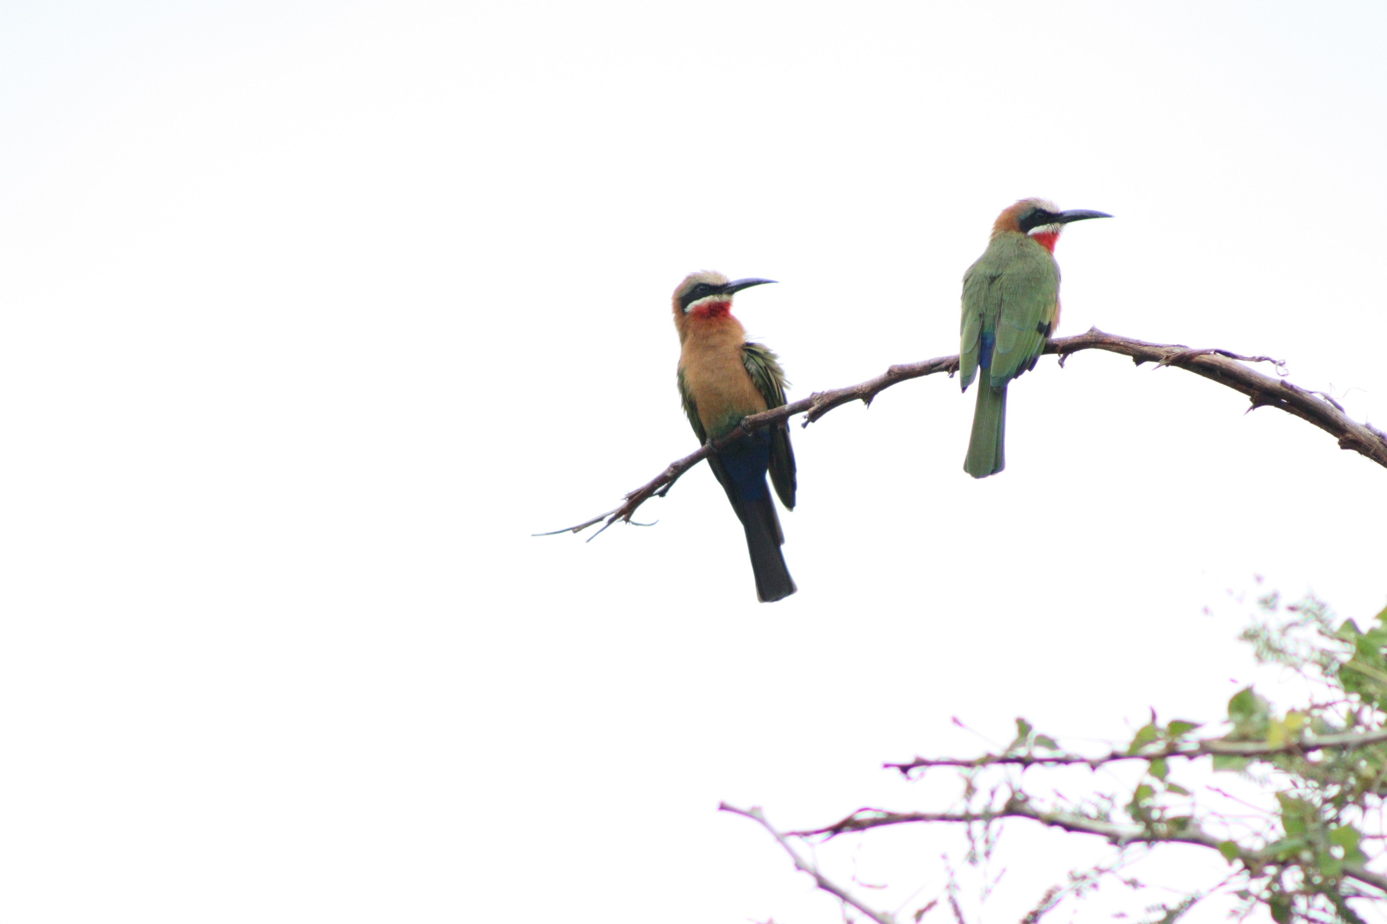
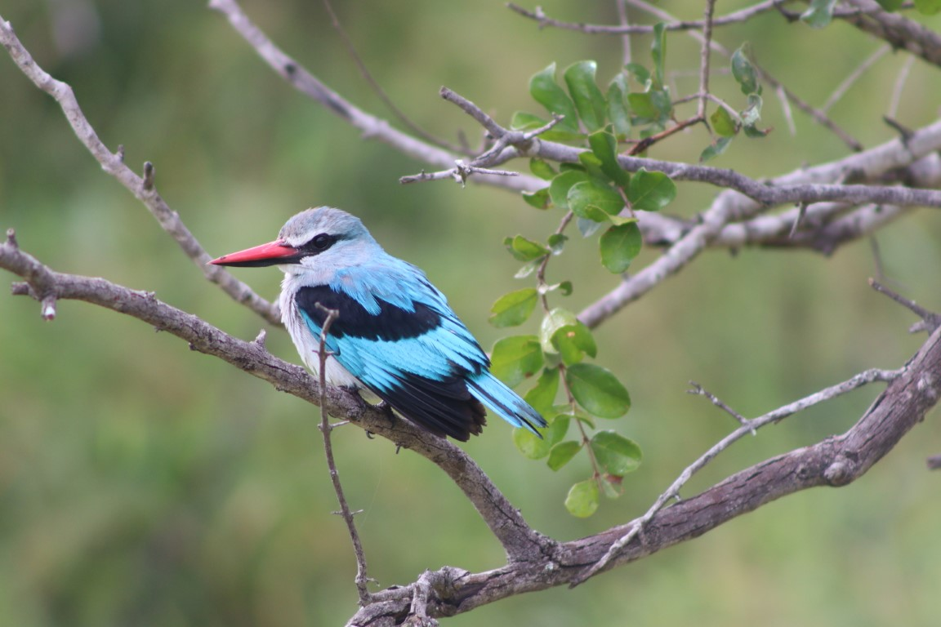
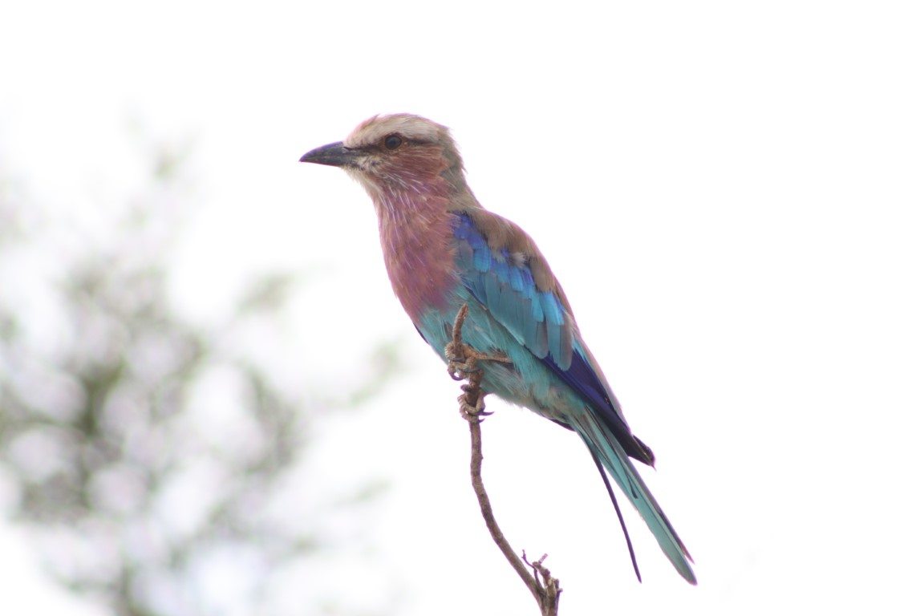
Our Dataset
Visual Representation
Photo
Our Dataset

Slide 17
Our Dataset
Visual Representation
Hunting Dogs
Brexit?
Elephant Eye
Photo
Name
Buffalo Bulls
Leopard Hunt
Stripes
Nyala Drink
Lioness
Coffee!
Bee-Eaters
Kingfisher
Colours!
Our Dataset

Slide 18
Our Dataset
Visual Representation
1
2
3
Photo
Name
Animal Key
Key | Animal | Class
1 | Wild Dog | Canine
2 | Roller | Bird
3 | Elephant | Ungulates
4 | Buffalo | Ungulates
5 | Leopard | Feline
6 | Zebra | Ungulates
7 | Nyala | Ungulates
8 | Lion | Feline
9 | Bee-Eater | Bird
10 | Kingfisher | Bird
4
5
6
7
8
8
9
10
2
Our Dataset

Slide 19
Our Dataset
Visual Representation
5
4
1
Photo
Name
Animal Key
Subcategory Key
1
1
2
Key | Subcategory | Category
1 | Big 5 | Mammals
2 | Grazers | Mammals
3 | Fishing Birds | Birds
4 | Insect Eaters | Birds
5 | Predators | Mammals
2
1
1
4
3
4
Our Dataset

Slide 20
Our Dataset
Visual Representation
Morning
Afternoon
Afternoon
Photo
Name
Animal Key
Subcategory Key
Time of Day
Morning
Evening
Morning
Afternoon
Night
Morning
Afternoon
Afternoon
Evening
Our Dataset

Slide 21
Our Dataset
Visual Representation
Group
Portrait
Close-Up
Photo
Name
Animal Key
Subcategory Key
Time of Day
Type
Group
Close-Up
Group
Group
Close-Up
Portrait
Scene
Portrait
Portrait
Our Dataset

Slide 22
Our Dataset
Visual Representation
Black
Blue
Grey
Photo
Name
Animal Key
Subcategory Key
Time of Day
Type
Primary Subject Colour
Brown
Gold
Black
Brown
Gold
Gold
Green
Blue
Lilac
Our Dataset

Slide 23
Our Dataset
Visual Representation
Brown
Green
Green
Photo
Name
Animal Key
Subcategory Key
Time of Day
Type
Primary Subject Colour
Primary Background Colour
Grey
Brown
Green
Brown
Black
Green
White
Green
White
Our Dataset

Slide 24
Our Dataset
Visual Representation
★ ★ ☆ ☆ ☆
★ ★ ★ ★ ☆
★ ★ ★ ★ ☆
Photo
Name
Animal Key
Subcategory Key
Time of Day
Type
Primary Subject Colour
Primary Background Colour
Subject Rating
★ ★ ★ ☆ ☆
★ ★ ★ ★ ★
★ ★ ☆ ☆ ☆
★ ★ ☆ ☆ ☆
★ ★ ★ ★ ☆
★ ★ ★ ☆ ☆
★ ★ ★ ★ ☆
★ ★ ★ ★ ☆
★ ★ ★ ★ ☆
Our Dataset

Slide 25
Our Dataset
Visual Representation
★ ★ ★ ☆ ☆
★ ★ ★ ★ ☆
★ ★ ☆ ☆ ☆
Photo
Name
Animal Key
Subcategory Key
Time of Day
Type
Primary Subject Colour
Primary Background Colour
Subject Rating
Background Rating
★ ★ ★ ☆ ☆
★ ★ ★ ★ ☆
★ ★ ☆ ☆ ☆
★ ★ ☆ ☆ ☆
★ ★ ★ ★ ☆
★ ★ ☆ ☆ ☆
★ ★ ★ ☆ ☆
★ ★ ★ ★ ☆
★ ★ ★ ☆ ☆
Our Dataset

Slide 26
Our Dataset
Visual Representation
8
1
1
Photo
Name
Animal Key
Subcategory Key
Time of Day
Type
Primary Subject Colour
Primary Background Colour
Subject Rating
Background Rating
# of Subjects
6
1
8
14
1
1
2
1
1
Our Dataset

Slide 27
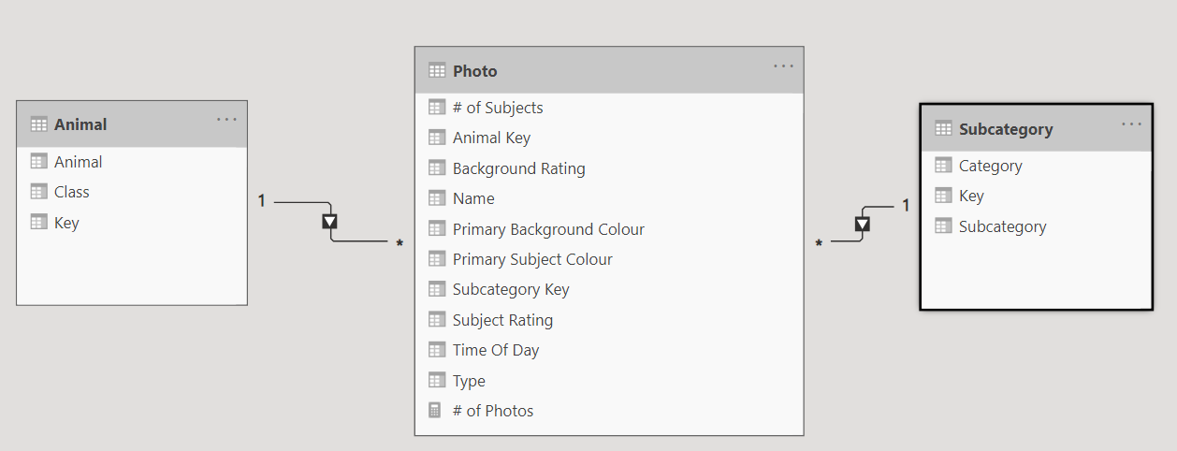
Our Dataset
Power BI Model
Our Dataset

Slide 28




Our Dataset
Questions
HOW MANY
images?
TOTAL SUBJECTS
in images?
WHAT’S THE AVERAGE
subject rating?
WHAT’S THE HIGHEST
background rating?
Our Dataset

Slide 29
Our Dataset
Simple Measures
HOW MANY
[# of Photos] := COUNTROWS ( Photo )
images?
TOTAL SUBJECTS
[Total # of Subjects] := SUM ( Photo[# of Subjects] )
in images?
WHAT’S THE AVERAGE
[Average Subject Rating] := AVERAGE ( Photo[Subject Rating] )
subject rating?
WHAT’S THE HIGHEST
[Highest Background Rating] := MAX ( Photo[Background Rating] )
background rating?
Our Dataset

Slide 30
Section Title 3
Filter Context

Slide 31
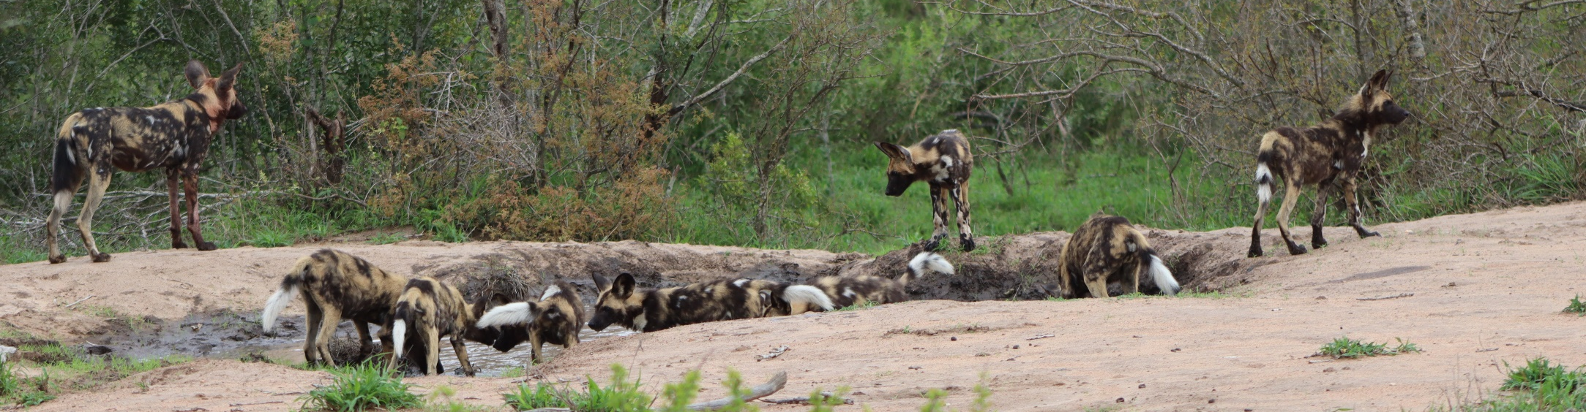
Filter context determines the underlying dataset on which a calculation takes place

Slide 32
Filter Context
No Filters
HOW MANY
images?
TOTAL SUBJECTS
in mages?
WHAT’S THE AVERAGE
subject rating?
WHAT’S THE HIGHEST
background rating?
Filter Context

Slide 33
Filter Context
No Filters
HOW MANY
images?
[# of Photos] := COUNTROWS ( Photo )
12
Filter Context

Slide 34
Filter Context
No Filters
8
1
1
TOTAL SUBJECTS
in images?
6
1
8
[Total # of Subjects] := SUM ( Photo[# of Subjects] )
45
14
1
1
2
1
1
Filter Context

Slide 35
Filter Context
No Filters
★ ★ ☆ ☆ ☆
★ ★ ★ ★ ☆
★ ★ ★ ★ ☆
WHAT’S THE AVERAGE
subject rating?
★ ★ ★ ☆ ☆
★ ★ ★ ★ ★
★ ★ ☆ ☆ ☆
[Average Subject Rating] := AVERAGE ( Photo[Subject Rating] )
3.42
★ ★ ☆ ☆ ☆
★ ★ ★ ★ ☆
★ ★ ★ ☆ ☆
★ ★ ★ ★ ☆
★ ★ ★ ★ ☆
★ ★ ★ ★ ☆
Filter Context

Slide 36
Filter Context
No Filters
★ ★ ★ ☆ ☆
★ ★ ★ ★ ☆
★ ★ ☆ ☆ ☆
WHAT’S THE HIGHEST
background rating?
★ ★ ★ ☆ ☆
★ ★ ★ ★ ☆
★ ★ ☆ ☆ ☆
[Highest Background Rating] := MAX ( Photo[Background Rating] )
4
★ ★ ☆ ☆ ☆
★ ★ ☆ ☆ ☆
★ ★ ☆ ☆ ☆
★ ★ ★ ☆ ☆
★ ★ ★ ★ ☆
★ ★ ★ ☆ ☆
Filter Context

Slide 37


What influences Filter Context?
Filters
Slicers
Book -, Page- and Visual Level filters will all affect the context
Slicer selections
Filter Context

Slide 38
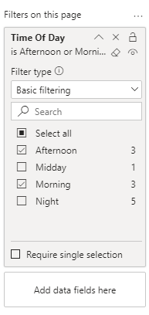
Filter Context
Filters
Morning
Afternoon
Afternoon
HOW MANY
images?
Morning
Evening
Morning
[# of Photos] := COUNTROWS ( Photo )
9
Afternoon
Night
Morning
Afternoon
Afternoon
Evening
Filter Context

Slide 39
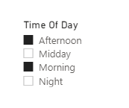
Filter Context
Slicers
8
1
Morning
Afternoon
Afternoon
1
TOTAL SUBJECTS
in images?
Evening
Morning
Morning
8
6
[Total # of Subjects] := SUM ( Photo[# of Subjects] )
42
Afternoon
Night
Morning
14
1
Afternoon
Afternoon
Evening
2
1
Filter Context

Slide 40

What influences Filter Context?
Filters
Slicers
Book -, Page- and Visual Level filters will all affect the context
Slicer selections
Within Visuals
Axes | Legends | Details
Rows | Columns
Filter Context

Slide 41
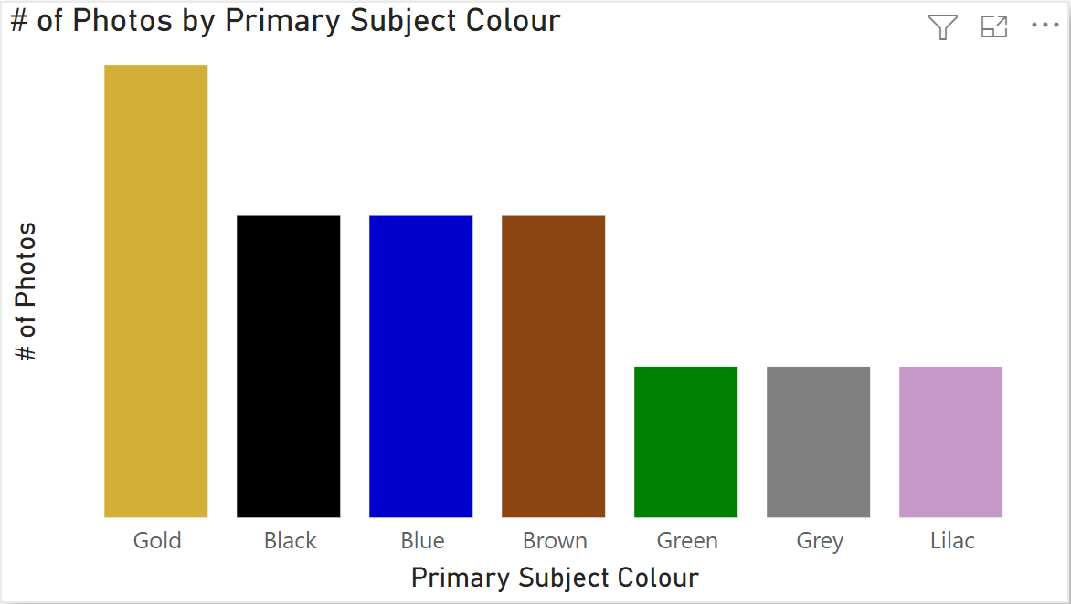
Filter Context
Within Visuals
Black
Blue
Grey
HOW MANY
images?
Brown
Gold
Black
[# of Photos] := COUNTROWS ( Photo )
Brown
Gold
Gold
Green
Blue
Lilac
Filter Context

Slide 42
Filter Context
Within Visuals
Black
Blue
Grey
HOW MANY
images?
Brown
Gold
Black
[# of Photos] := COUNTROWS ( Photo )
Brown
Gold
Gold
Green
Blue
Lilac
Filter Context
3
2
2
2
1
1
1

Slide 43
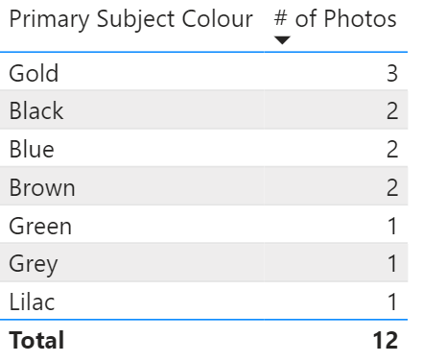
Filter Context
Within Visuals
Black
Blue
Grey
HOW MANY
images?
Brown
Gold
Black
[# of Photos] := COUNTROWS ( Photo )
Brown
Gold
Gold
Green
Blue
Lilac
Filter Context

Slide 44

What influences Filter Context?
Filters
Slicers
Book -, Page- and Visual Level filters will all affect the context
Slicer selections
External Visuals
Within Visuals
User interactions with other visual
*Depending on Visual Interactions settings
Axes | Legends | Details
Rows | Columns
Filter Context

Slide 45
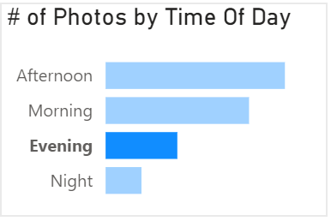
Filter Context
External Visuals
Morning
Afternoon
Afternoon
WHAT’S THE AVERAGE
subject rating?
Morning
Evening
Morning
★ ★ ★ ★ ★
[Average Subject Rating] := AVERAGE ( Photo[Subject Rating] )
3.42
4.5
Afternoon
Night
Morning
Afternoon
Evening
Afternoon
★ ★ ★ ★ ☆
Filter Context

Slide 46
Filter Context

Slide 47

Filter Context: Recap
EVERY DATA POINT IS CALCULATED WITHIN ITS OWN FILTER CONTEXT
TOTAL CALCULATIONS HAVE AN EXPLICIT FILTER CONTEXT
Understanding explicit filter context (visible on report) is the first step towards mastering DAX. Later, we will learn how to create and modify filter contexts from within DAX formulas
FILTER CONTEXT RESPECTS EXPLICIT RELATIONSHIPS
FILTER CONTEXT IS CUMULATIVE
FILTER CONTEXT IS EVALUATED FIRST
1 FORMULA: MANY RESULTS
Filter Context

Slide 48
Section Title 3
Row Context

Slide 49
Overall Rating
★ ★
★ ★ ★ ★
★ ★ ★ ★
(2 * [Subject Rating])
+
[Background Rating]
★ ★ ★
★ ★ ★ ★
★ ★
★ ★ ★
★ ★ ★ ★ ★
★ ★
★ ★ ★
★ ★ ★ ★
★ ★
★ ★
★ ★ ★ ★
★ ★ ★
★ ★
★ ★ ★ ★
★ ★
★ ★ ★ ★
★ ★ ★ ★
★ ★ ★ ★
★ ★ ★
★ ★ ★ ★
★ ★ ★
Row Context

Slide 50

SOMETHING THAT WON’T WORK
[Average Overall Rating] := AVERAGE (
(Photo[Subject Rating] * 2) + Photo[Background Rating]
)
Row Context

Slide 51
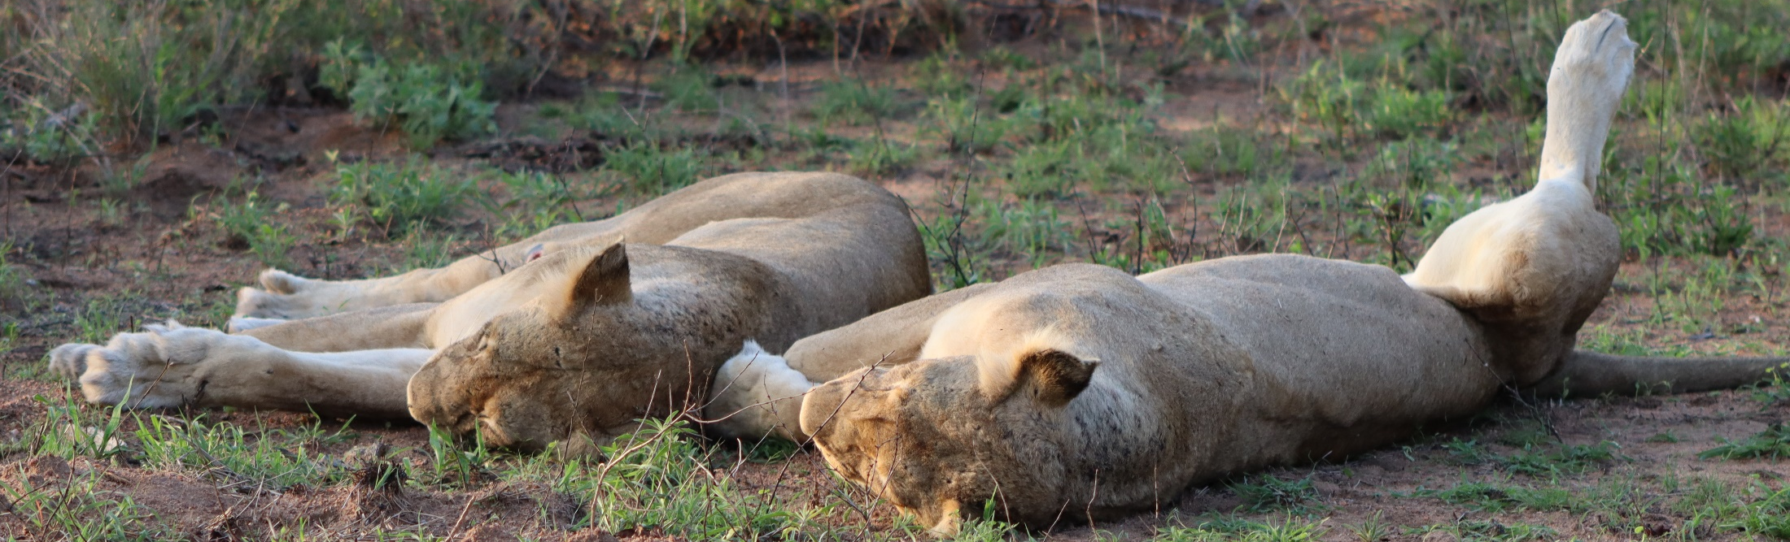
Row Context is the internal “pointer” within a DAX calculation which allows the engine to know which row it is currently iterating over.
Row Context

Slide 52
When is a Row Context created?
WHEN WE CREATE A CALCULATED COLUMN
WHEN COMPUTING AN EXPRESSION INSIDE AN ITERATION
Row Context

Slide 53
Row Context
★ ★
★ ★ ★ ★
★ ★ ★ ★
Calculated Column
7
7
7
★ ★ ★
★ ★ ★ ★
★ ★
WHAT’S THE AVERAGE
OVERALL RATING
★ ★ ★
★ ★ ★ ★ ★
★ ★
7
5
8
★ ★ ★
★ ★ ★ ★
★ ★
CREATE A CALCULATED COLUMN
[Overall Rating] = Photo[Subject Rating] + Photo[Background Rating]
★ ★
★ ★ ★ ★
★ ★ ★
6
4
6
★ ★
★ ★ ★ ★
★ ★
[Average Subject Rating] := AVERAGE ( Photo[Overall Rating] )
★ ★ ★ ★
★ ★ ★ ★
★ ★ ★ ★
5
6
9
★ ★ ★
★ ★ ★ ★
★ ★ ★
Filter Context

Slide 54
5
8
6
Row Context
★ ★
★ ★ ★ ★
★ ★ ★ ★
Iterator Function
★ ★ ★
★ ★ ★ ★
★ ★
6
9
4
WHAT’S THE AVERAGE
OVERALL RATING
★ ★ ★
★ ★ ★ ★ ★
★ ★
★ ★ ★
★ ★ ★ ★
★ ★
CREATE A CALCULATED COLUMN
4
8
5
MEASURE USING ITERATOR FUNCTION
[Average Subject Rating] := AVERAGEX (
Photo,
Photo[Subject Rating] +
Photo[Background Rating]
)
★ ★
★ ★ ★ ★
★ ★ ★
★ ★
★ ★ ★ ★
★ ★
7
8
8
★ ★ ★ ★
★ ★ ★ ★
★ ★ ★ ★
★ ★ ★
★ ★ ★ ★
★ ★ ★
Filter Context

Slide 55
Section Title 3
Calculate

Slide 56
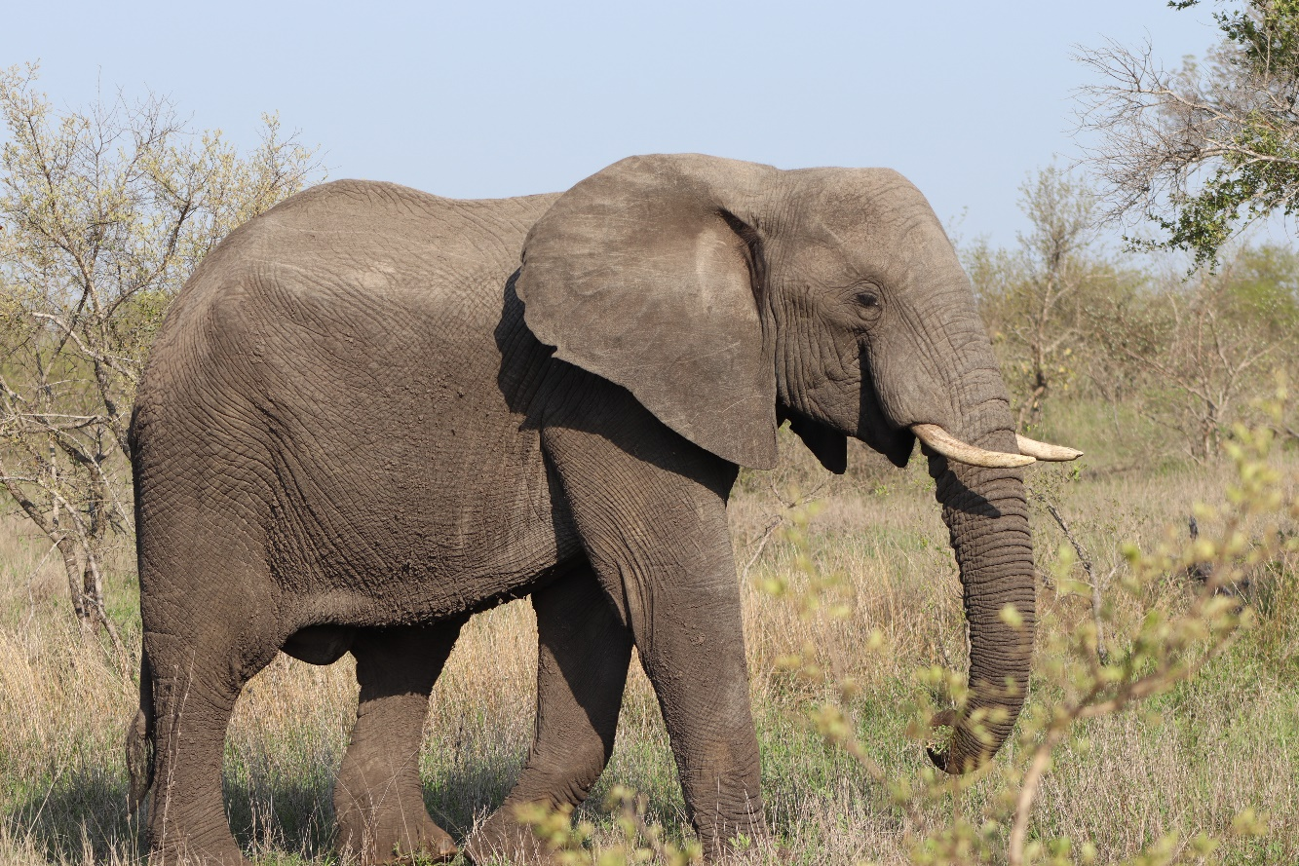
The CALCULATE Function allows us to MODIFY the FILTER CONTEXT of a formula.
CALCULATE

Slide 57



REDUCE
EXPAND
SHIFT
Refine the FILTER CONTEXT by ADDING additional filters.
Expand the FILTER CONTEXT by REMOVING filters.
Change the filter context by ALTERING filters.
FILTER
ALL
VARIOUS
FUNCTIONS
CALCULATE

Slide 58
Filter Context
No Filters
Black
Blue
Grey
HOW MANY BLACK
images?
Gold
Black
Brown
Black
[# of Black Photos] := CALCULATE
(
[# of Photos],
Photo[Primary Subject Colour] = “Black”
)
Brown
Gold
Gold
2
Green
Blue
Lilac
Filter Context

Slide 59
What happens if we have external filters?
FILTER CONTEXT IS RESPECTED UNLESS EXPLICITLY OVERRIDDEN
CALCULATE

Slide 60
EXPAND - REMOVE FILTERS
ALL ( Table )
Overrides all filters on any column within a table (includes filter via relationships)
ALL ( Table[Column(s)])
Overrides all filters on specific column(s) within a table (includes filter via relationships)
CALCULATE

Slide 61
CALCULATE

Slide 62
Section Title 3
Modifying Relationships

Slide 63
Group
Portrait
Close-Up
[Distinct # of Animal Classes] = DISTINCTCOUNT ( Animal[Class] )
Group
Close-Up
Group
Class
Feline
Canine
Ungulate
Bird
Group
Close-Up
Portrait
4
Scene
Portrait
Portrait
Modifying Relationships

Slide 64
# of Distinct Animal Classes - CROSSFILTER =
CALCULATE(
DISTINCTCOUNT ( Animal[Class] ),
CROSSFILTER
( Animal[Key],
Photo[Animal Key],
BOTH )
)
Portrait
Class
Feline
Canine
Ungulate
Bird
Class
Feline
Bird
Portrait
4
2
Portrait
Portrait
Modifying Relationships

Slide 65


Other Relationship Modifiers
RELATED
RELATEDTABLE
Returns related value from another table
Returns the related tables filtered so that it only includes the related rows.
CROSSFILTER
USERELATIONSHIP
Specifies cross filtering direction to be used in the evaluation of a DAX expression. The relationship is defined by naming, as arguments, the two columns that serve as endpoints.
Specifies an existing relationship to be used in the evaluation of a DAX expression. The relationship is defined by naming, as arguments, the two columns that serve as endpoints.
Modifying Relationships

Slide 66
Modifying Relationships

Slide 67
Section Title 3
Context Transitions

Slide 68
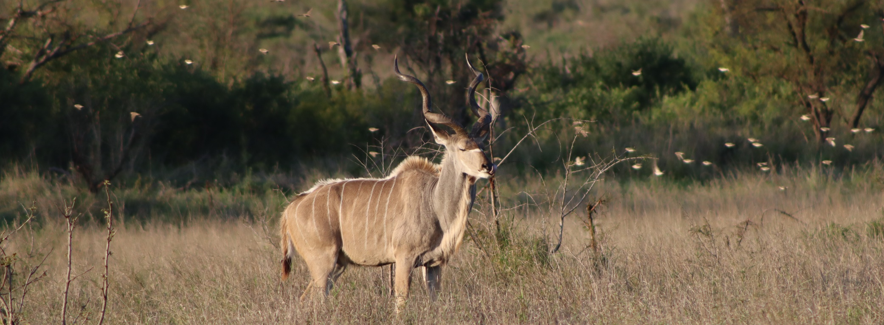
CONTEXT TRANSITION is using the ROW CONTEXT to create a new FILTER CONTEXT.

Slide 69
Context Transition Example := SUMX ( Photo, VAR v_myNumberOfSubjects = Photo[# of Subjects] RETURN CALCULATE ( COUNTROWS ( Photo ), ALL ( Photo ), Photo[# of Subjects] >= v_myNumberOfSubjects ) )

Slide 70
Context Transition

Slide 71
Section Title 3
Questions

Slide 72


James McGillivray
Session
Materials
/thejimmyrsa
james@cobaltanalytics.io
Please fill out the session evaluation

